Slide 2
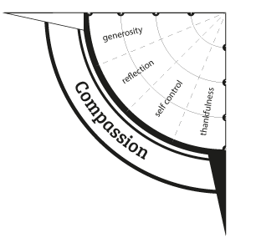
Compassion is a word that is used a lot but is often misunderstood…
What does it actually mean?
Have a listen to this lot…
Watch this…

Slide 4
People often assume that COMPASSION is simply “being nice” but it is more than that, it involves putting aside your own interests to help others.

Slide 5
40acts is a daily generosity challenge that runs throughout the period of Lent, created by the charity Stewardship.
During 2019, 100,000+ individuals and thousands of groups took the 40acts challenge, creating a wave of more than 4million generous acts in 180 countries around the world.
Having had a break in 2019, we are going to join in during 2020…

Slide 6
30 seconds silent reflection…
If compassion is more than “being nice” what could you do today or during this half term to make a real difference in someone’s life?
What price are you willing to pay so that others can experience comfort, hope, joy or happiness?

Slide 7
Prayer
Lord, forgive us for our lack of generosity for, compassion toward and understanding of the poor. Help us to see them as you see them and to behave and think in a loving way. Thank you that you do not value people according to their status or resources but love everyone because you made us all.
Amen

